Slide 1

Free Knowledge Mission “The Word’s Best Teachers”

Slide 2
Classroom Meetup
Email Github
YouTube
Free Knowledge

Slide 3
Classroom, YouTube, & GitHub
5 Year Plan
Science
Language
Wellness
Music
Art
Theology
2017
2022
TBD
2018
TBD
TBD

Slide 4
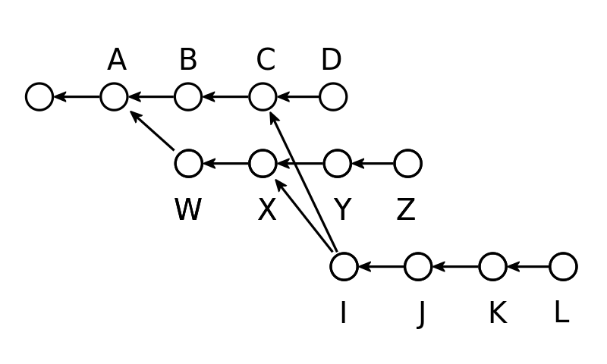
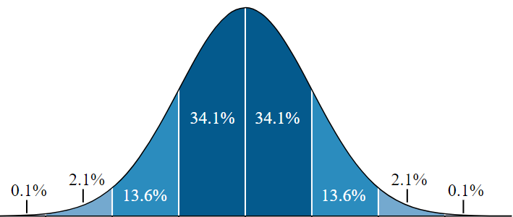
How does this all work?

Slide 5
Science
Astronomy
Biology
Data

Slide 6
Music
Instruments
Singing
Composing

Slide 7
Wellness
Nutrition
Exercise
Sleep

Slide 8
Art
Digital
Sculpting
Painting

Slide 9
Theology
Who needs religion?
Christian
Open ☺

Slide 10
Language
Mandarin
Spanish
Hindi

Slide 11
Science
Theology
Language
Art
Music
Wellness
Truth & Beauty

